Slide 1
Building Android apps – Week 2b
2843-201710_MCS4993_M:Topics in MA/CS
2843-201710_MCS5993_M:Topics in Computer Science

Slide 2
Agenda
Chapter 3 HFAD – Multiple Activities and Intents
Chapter 4 HFAD – Activity Lifecycyle
Notes:
Most users want to do more than one thing so Most apps need more than one activity. An activity is a single focused thing your user can do. If you chain multiple activities together to do something more complex, it’s called a task.

Slide 3
Multiple Activities
Notes:
HERE ARE THE STEPS
Create a basic app with a single activity and layout.
Add a second activity and layout.
Get the first activity to call the second activity.
Get the first activity to pass data to the second activity.

Slide 4
Multiple Activities
Notes:
The app contains two activities and two layouts.
When the app gets launched, it starts activity CreateMessageActivity.
This activity uses the layout activity_create_message.xml.
The user clicks on a button in CreateMessageActivity.
This launches activity ReceiveMessageActivity, which uses layout activity_receive_message.xml.

Slide 5
Multiple Activities
Create 1st activity
Create 2nd activity
Call 2nd activity
Pass Data
Notes:
To create the app we’re going to take the following steps.

Slide 6
Multiple Activities
A task is two or more activities chained together.
The <EditText> element defines an editable text field for entering text. It inherits from the Android View class.
You can add a new activity in Android Studio by choosing File → New... → Activity.
Each activity you create must have an entry in AndroidManifest.xml.
An intent is a type of message that Android components use to communicate with one another.
An explicit intent explicitly specifies the component the intent is targeted at. You create an explicit intent using Intent intent = new Intent(this, Target.class);
To start an activity, call startActivity(intent). If no activities are found, it throws an ActivityNotFoundException.
Use the putExtra() method to add extra information to an intent.
Use the getIntent() method to retrieve the intent that started the activity
Notes:
A task is two or more activities chained together.
The <EditText> element defines an editable text field for entering text. It inherits from the Android View class.
You can add a new activity in Android Studio by choosing File → New... → Activity.
Each activity you create must have an entry in AndroidManifest.xml.
An intent is a type of message that Android components use to communicate with one another.
An explicit intent explicitly specifies the component the intent is targeted at. You create an explicit intent using Intent intent = new Intent(this, Target.class);
To start an activity, call startActivity(intent). If no activities are found, it throws an ActivityNotFoundException.
Use the putExtra() method to add extra information to an intent.
Use the getIntent() method to retrieve the intent that started the activity.

Slide 7
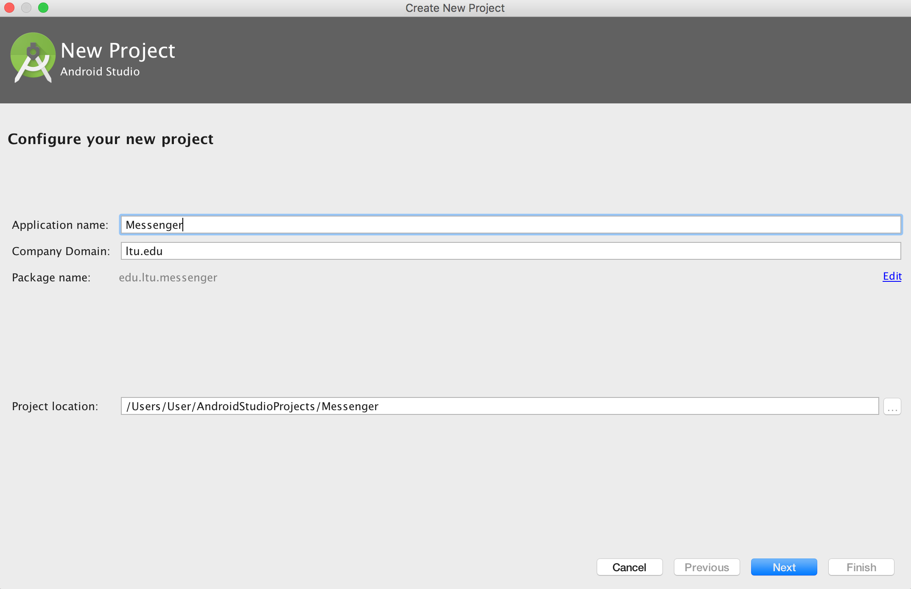
Create 1st Activity
Notes:
Create a new Android Studio project for an application named “Messenger” with a package name of com.hfad.messenger. The minimum SDK should be API 15 so that it will work on most devices. You’ll need a blank activity called “CreateMessageActivity” with a layout called “activity_create_message” so that your code matches ours.

Slide 8
Create 1st Activity
Notes:
Here’s the XML for the activity_create_message.xml file. We removed the <TextView> that Android Studio created for us, and replaced it with <Button> and <EditText> elements. The <EditText> element gives you an editable text field you can use to enter data.

Slide 9
Create 1st Activity
Notes:
The <EditText> element defines an editable text field for entering text.

Slide 10
Create 1st Activity
Notes:
The button we added has a text value of @string/send. This means we need to add a string called “send” to strings.xml and give it a value. This value is the text we want to appear on the button.

Slide 11
Create 1st Activity
Notes:
The line in the <Button> elementandroid:onClick="onSendMessage"means that the onSendMessage() method in the activity will fire when the button is clicked. Let’s add this method to the activity now.Open up the CreateMessageActivity.java file and replace the code Android Studio created for you with the following:

Slide 12
Create 2nd Activity
Notes:
Android Studio has a wizard that lets you add extra activities and layouts to your apps. To create the new activity, choose File → New → Activity, and choose the option for Blank Activity.
Give the new activity a name of “ReceiveMessageActivity” and the layout a name of “activity_receive_message”.

Slide 13
Create 2nd Activity
Notes:
Android Studio has a wizard that lets you add extra activities and layouts to your apps. To create the new activity, choose File → New → Activity, and choose the option for Blank Activity.
Give the new activity a name of “ReceiveMessageActivity” and the layout a name of “activity_receive_message”.

Slide 14
Create 2nd Activity
Notes:
Each activity uses a different layout. CreateMessageActivity uses the layout activity_create_message.xml, and ReceiveMessageActivity uses the layout activity_receive_message.xml.

Slide 15
Create 2nd Activity
Notes:
Behind the scenes, Android Studio also made a configuration change to the app in a file calledAndroidManifest.xml If you develop Android apps without an IDE, you’ll need to create this file manually.
All activities need to be declared in AndroidManifest.xml. If an activity isn’t declared in the file, the system won’t know it exists. And if the system doesn’t know it exists, the activity will never run.

Slide 16
Create 2nd Activity
Notes:
You declare an activity in the manifest by including an <activity> element inside the <application> element. In fact, every activity in your app needs a corresponding <activity> element. Here’s the general format:

Slide 17
Create 2nd Activity
Notes:
Whenever you want an activity to start a second activity, you use an intent. It’s a type of message that allows you to bind separate objects (such as activities) together at runtime. If one activity wants to start a second activity, it does it by sending an intent to Android. Android will start the second activity and pass it the intent. The first parameter tells Android which object the intent is from, and you can use the word this to refer to the current activity. The second parameter is the class name of the activity that needs to receive the intent.

Slide 18
Create 2nd Activity
Notes:
Once you’ve created the intent, you pass it to Android like this: This tells Android to start the activity specified by the intent.
Once Android receives the intent, it checks everything’s OK and tells the activity to start. If it can’t find the activity, it throws an ActivityNotFoundException.

Slide 19
Create 2nd Activity

Slide 20
Create 2nd Activity
Notes:
Let’s put this into practice and use an intent to call ReceiveMessageActivity. We want to launch the activity when the user clicks on the Send Message button, so we’ll add the two lines of code to our onSendMessage() method.

Slide 21
Call 2nd Activity
Notes:
1. When the app gets launched, the main activity, CreateMessageActivity starts.
2. The user clicks on a button.The onSendMessage() method in CreateMessageActivity responds to the click.
3. The onSendMessage() method tells Android to start activity ReceiveMessageActivity using an intent.Android checks that the intent is OK, and then it tells ReceiveMessageActivity to start.

Slide 22
Call 2nd Activity
Notes:
When ReceiveMessageActivity starts, it specifies that it uses layout activity_receive_message.xml and this gets displayed in a new window.

Slide 23
Call 2nd Activity
Notes:
CreateMessageActivity starts, and when you click on the Send Message button, it launches ReceiveMessageActivity.

Slide 24
Pass Data
Notes:
So far we’ve coded CreateMessageActivity to start ReceiveMessageActivity when the Send Message button is pressed. Next, we’ll get CreateMessageActivity to pass text toReceiveMessageActivity so that ReceiveMessageActivity can display it. In order to accomplish this, we’ll do three things:
Tweak the layout activity_receive_message.xml so that we can display the text. At the moment it’s the default layout the wizard gave us.
Update CreateMessageActivity.xml so that it gets the text the user inputs. It then needs to add the text to the intent before it sends it.
Update ReceiveMessageActivity.java so that it displays the text sent in the intent.

Slide 25
Pass Data

Slide 26
Pass Data
Notes:
First, we need to give the <TextView> element an ID. You have to add an ID to any GUI components you need to reference in your activity code, as this gives you a way of referencing it in your Java code. We also need to stop the text “Hello world!” from appearing.

Slide 27
Pass Data – Send Data
intent.putExtra("message", value);
Notes:
You can add extra information to this intent that can be picked up by the activity you’re targeting so it can react in some way. To do this, you use the putExtra() method
where message is a String name for the value you’re passing in, and value is the value. The putExtra()method is overloaded so value has many possible types. As an example, it can be a primitive such as aboolean or int, an array of primitives, or a String. You can use putExtra() repeatedly to add numerous extra data to the intent. If you do this, make sure you give each one a unique name.

Slide 28
Pass Data – Receive Data
Notes:
When Android tells ReceiveMessageActivity to start,ReceiveMessageActivity needs some way of retrieving the extra information thatCreateMessageActivity sent to Android in the intent.
getIntent() returns the intent that started the activity, and you can use this to retrieve any extra information that was sent along with it. How you do this depends on the type of information that was sent. As an example, if you know the intent includes a String value with a name of “message”, you would use the following:

Slide 29
Pass Data – Send Data
Notes:
We updated our code for CreateMessageActivity.java so that it takes the text the user enters on the screen and adds it to the intent.

Slide 30
Pass Data – Receive Data
Notes:
We updated our code for CreateMessageActivity.java so that it takes the text the user enters on the screen and adds it to the intent.

Slide 31
Multiple Activities - Recap
Notes:
When the user clicks on the button, the onSendMessage() method is called.
Code within the onSendMessage() method creates an intent to start activityReceiveMessageActivity, adds a message to the intent, and passes it to Android with an instruction to start the activity.

Slide 32
Multiple Activities - Recap
Notes:
Android checks that the intent is OK, and then tells ReceiveMessageActivity to start.

Slide 33
Multiple Activities - Recap
Notes:
When ReceiveMessageActivity starts, it specifies that it uses layout activity_receive_message. xml, and this gets displayed on the device.
The activity updates the layout so that it displays the extra text included in the intent.

Slide 34
Multiple Activities
A task is two or more activities chained together.
The <EditText> element defines an editable text field for entering text. It inherits from the Android View class.
You can add a new activity in Android Studio by choosing File → New... → Activity.
Each activity you create must have an entry in AndroidManifest.xml.
An intent is a type of message that Android components use to communicate with one another.
An explicit intent explicitly specifies the component the intent is targeted at. You create an explicit intent using Intent intent = new Intent(this, Target.class);
To start an activity, call startActivity(intent). If no activities are found, it throws an ActivityNotFoundException.
Use the putExtra() method to add extra information to an intent.
Use the getIntent() method to retrieve the intent that started the activity

Slide 35
Assignment
Chapter 1 HFAD – HelloWorld on Github (due today)
Email github link to gnolan@ltu.edu
Chapter 2 HFAD – BookWorld Github (due Tuesday)
Choose book categories, fiction, non-fiction, horror, drama and display different books for each category – use BeerAdviser code
Read Chapter 3

Slide 36
Chap 4 – Activity Lifecycle
Notes:
What happens when an Activity is created or destroyed. Which methods get called when an activity is made visible and appears in the foreground, and which get called when the activity loses the focus and is hidden? And how do you save and restore your activity’s state?

Slide 37
Chap 4 – Activity Lifecycle
Notes:
An app is a collection of activities, layouts, and other resources. One of these activities is the main activity for the app.

Slide 38
Chap 4 – Activity Lifecycle
Notes:
An app is a collection of activities, layouts, and other resources. One of these activities is the main activity for the app.
By default, each app runs within its own process.

Slide 39
Chap 4 – Activity Lifecycle
Notes:
You can start an activity in another application by passing an intent with startActivity().
The Android system knows about all the installed apps and their activities, and uses the intent to start the correct activity.

Slide 40
Chap 4 – Activity Lifecycle
Notes:
When an activity needs to start, Android checks if there’s already a process for that app.If one exists, Android runs the activity in that process. If one doesn’t exist, Android creates one.

Slide 41
Chap 4 – Activity Lifecycle
Notes:
When Android starts an activity, it calls its onCreate() method.
But there are still lots of things we don’t yet know about how activities function. How long does the activity live for? What happens when your activity disappears from the screen? Is it still running? Is it still in memory? And what happens if your app gets interrupted by an incoming phone call? We want to be able to control the behavior of our activities in a whole range of different circumstances, but how?

Slide 42
Chap 4 – Activity Lifecycle
Notes:
Chapter 4 looks at how activities work under the hood, common ways in which your apps can break, and how you can fix them using the activity lifecycle methods. The Stopwatch app consists of a single activity and a single layout. The layout includes a text view showing you how much time has passed, a Start button that starts the stopwatch, a Stop button that stops it, and a Reset button that resets the timer value to zero.

Slide 43
Chap 4 – Activity Lifecycle - Layout
Notes:
create a new Android project for an application named “Stopwatch” with a package name ofcom.hfad. stopwatch. The minimum SDK should be API 15 so it can run on most devices. You’ll need an activity called “StopwatchActivity” and a layout called “activity_stopwatch”.

Slide 44
Chap 4 – Activity Lifecycle
Notes:
Here’s the XML for the layout. It describes a single text view that’s used to display the timer, and three buttons to control the stopwatch.

Slide 45
Chap 4 – Activity Lifecycle - Layout
Notes:
The layout uses three extra String values, one for the text value of each button. These values are String resources, so need to be added to strings. xml.

Slide 46
Chap 4 – Activity Lifecycle - Layout
Notes:
Moving on to the activity - The layout defines three buttons that we’ll use to control the stopwatch. Each button uses its onClick attribute to specify which method in the activity should run when the button is clicked. When the Start button is clicked, the onClickStart() method gets called, when the Stop button is clicked the onClickStop() method gets called, and when the Reset button is clicked the onClickReset() method gets called. We’ll use these method to start, stop, and reset the stopwatch.

Slide 47
Chap 4 – Activity Lifecycle - Activity
Notes:
We’ll update the stopwatch using a method we’ll create called runTimer(). The runTimer() method will run code every second to check whether the stopwatch is running, increment the number of seconds and display the number of seconds in the text view. we’ll use two private variables to record the state of the stopwatch. We’ll use an int calledseconds to track how many seconds have passed since the stopwatch started running, and a boolean calledrunning to record whether the stopwatch is currently running.

Slide 48
Chap 4 – Activity
Notes:
StopwatchActivity.java – read out the image notes

Slide 49
Chap 4 – Activity
Notes:
The runTimer() method will get a reference to the text view in the layout, format the contents of the seconds variable into hours, minutes, and seconds, and then display the results in the text view. If the running variable is set to true, it will increment the seconds variable.
We need this code to keep looping so that it increments the seconds variable and updates the text view every second. We need to do this in such a way that we don’t block the main Android thread. Do this using a Handler

Slide 50
Chap 4 – Activity
Notes:
A Handler is an Android class you can use to schedule code that should be run at some point in the future. You can also use it to post code that needs to run on a different thread. In our case, we’re going to use a Handler to schedule the stopwatch code to run every second.

Slide 51
Chap 4 – Activity
Notes:
The postDelayed() method works in a similar way to the post() method except that you use it post code that should be run in the future. The postDelayed() method takes two parameters: a Runnable and a long. The Runnable contains the code you want to run in its run() method, and the long specifies the number of milliseconds you wish to delay the code by. The code will run as soon as possible after the delay.

Slide 52
Chap 4 – Activity
Notes:
To update the stopwatch, we’re going to repeatedly schedule code using the Handler with a delay of 1,000 milliseconds each time. Each time the code runs, we’ll increment the seconds variable and update the text view. Using the post() and postDelayed() methods in this way means that the code will run as soon as possible after the required delay, which in practice means almost immediately. While this means the code will lag slightly over time, it’s accurate enough for the purposes of exploring the lifecycle methods in this chapter.

Slide 53
Chap 4 – Activity
protected void onCreate(Bundle savedInstanceState) {
... runTimer();
}
Notes:
We want the runTimer() method to start running when StopwatchActivity gets created, so we’ll call it in the activity onCreate() method:

Slide 54
Chap 4 – Activity
Notes:
But there’s a problem – if we change the orientation, the app gets reset. Because of the Android lifecycle.

Slide 55
Assignment
Chapter 1 HFAD – HelloWorld on Github (due today)
Email github link to gnolan@ltu.edu
Chapter 2 HFAD – BookWorld Github (due Tuesday)
Choose book categories, fiction, non-fiction, horror, drama and display different books for each category – use BeerAdviser code
Read Chapter 3

